Slide 1
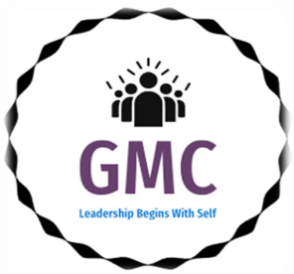

THE GREAT MINDS CORP INITIATIVE - AUNUA GLOBAL

Slide 2
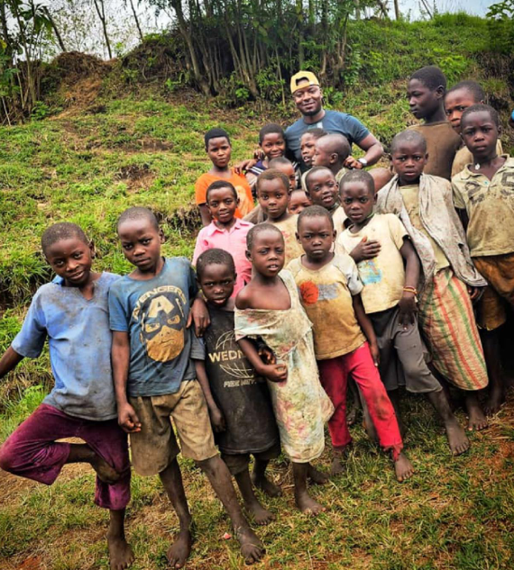
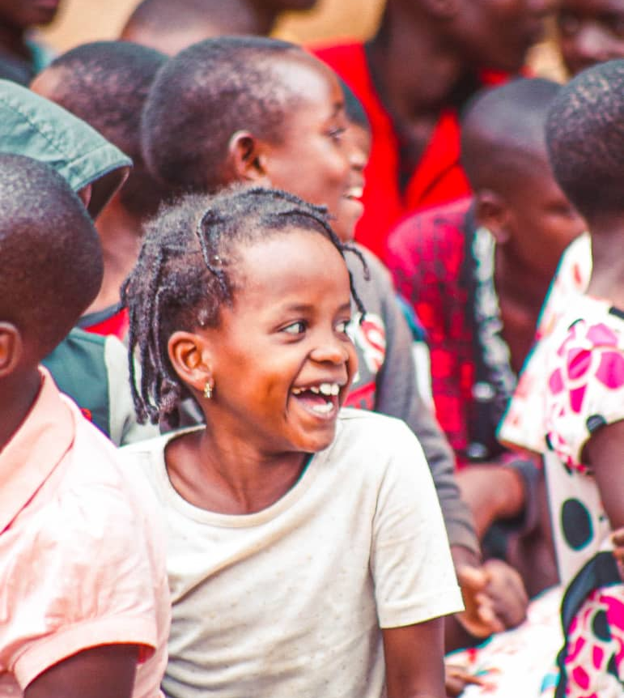
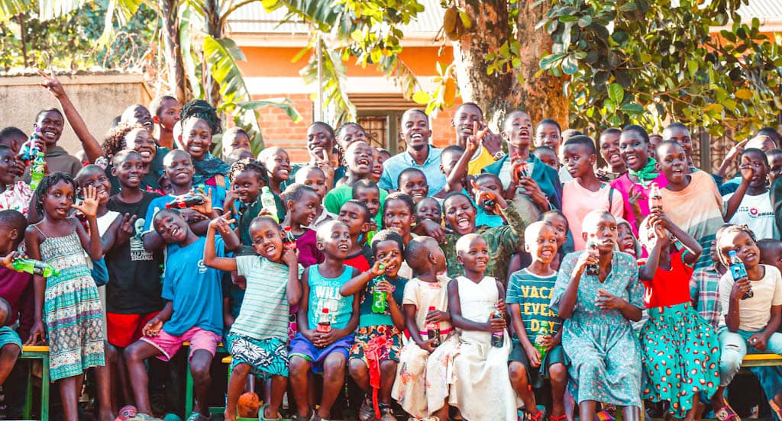
About
The GMC program addresses the critical challenges faced by women, youth and children from underprivileged communities such as lack of access to quality education, economic opportunities, and healthcare. Many individuals in these communities are stuck in cycles of poverty, limited by a lack of skills, knowledge and resources to break free and create sustainable livelihoods. This program provides a comprehensive solution to these problems by equipping individuals with essential skills, knowledge, and leadership tools, enabling them to transform their lives and uplift their communities.

Slide 3
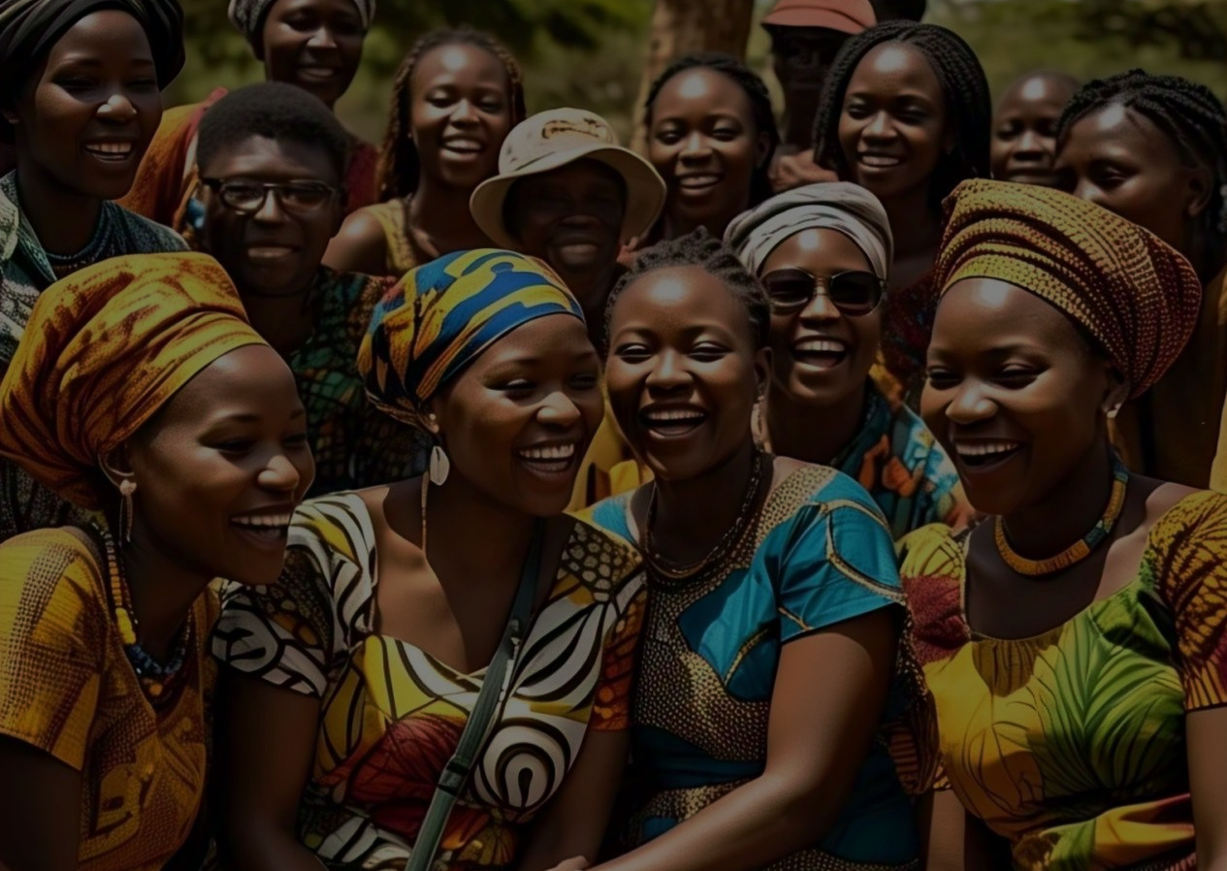
About
The program empowers women and young people to become self-sustaining change agents. By fostering a ripple effect, those who benefit from the program pass on their learnings to others, ultimately strengthening the foundation of their communities. AUNUA GLOBAL’s expertise is integral to expanding the program’s reach and impact, aligning perfectly with our shared mission to empower individuals toward self-sufficiency and long-term social change.

Slide 4
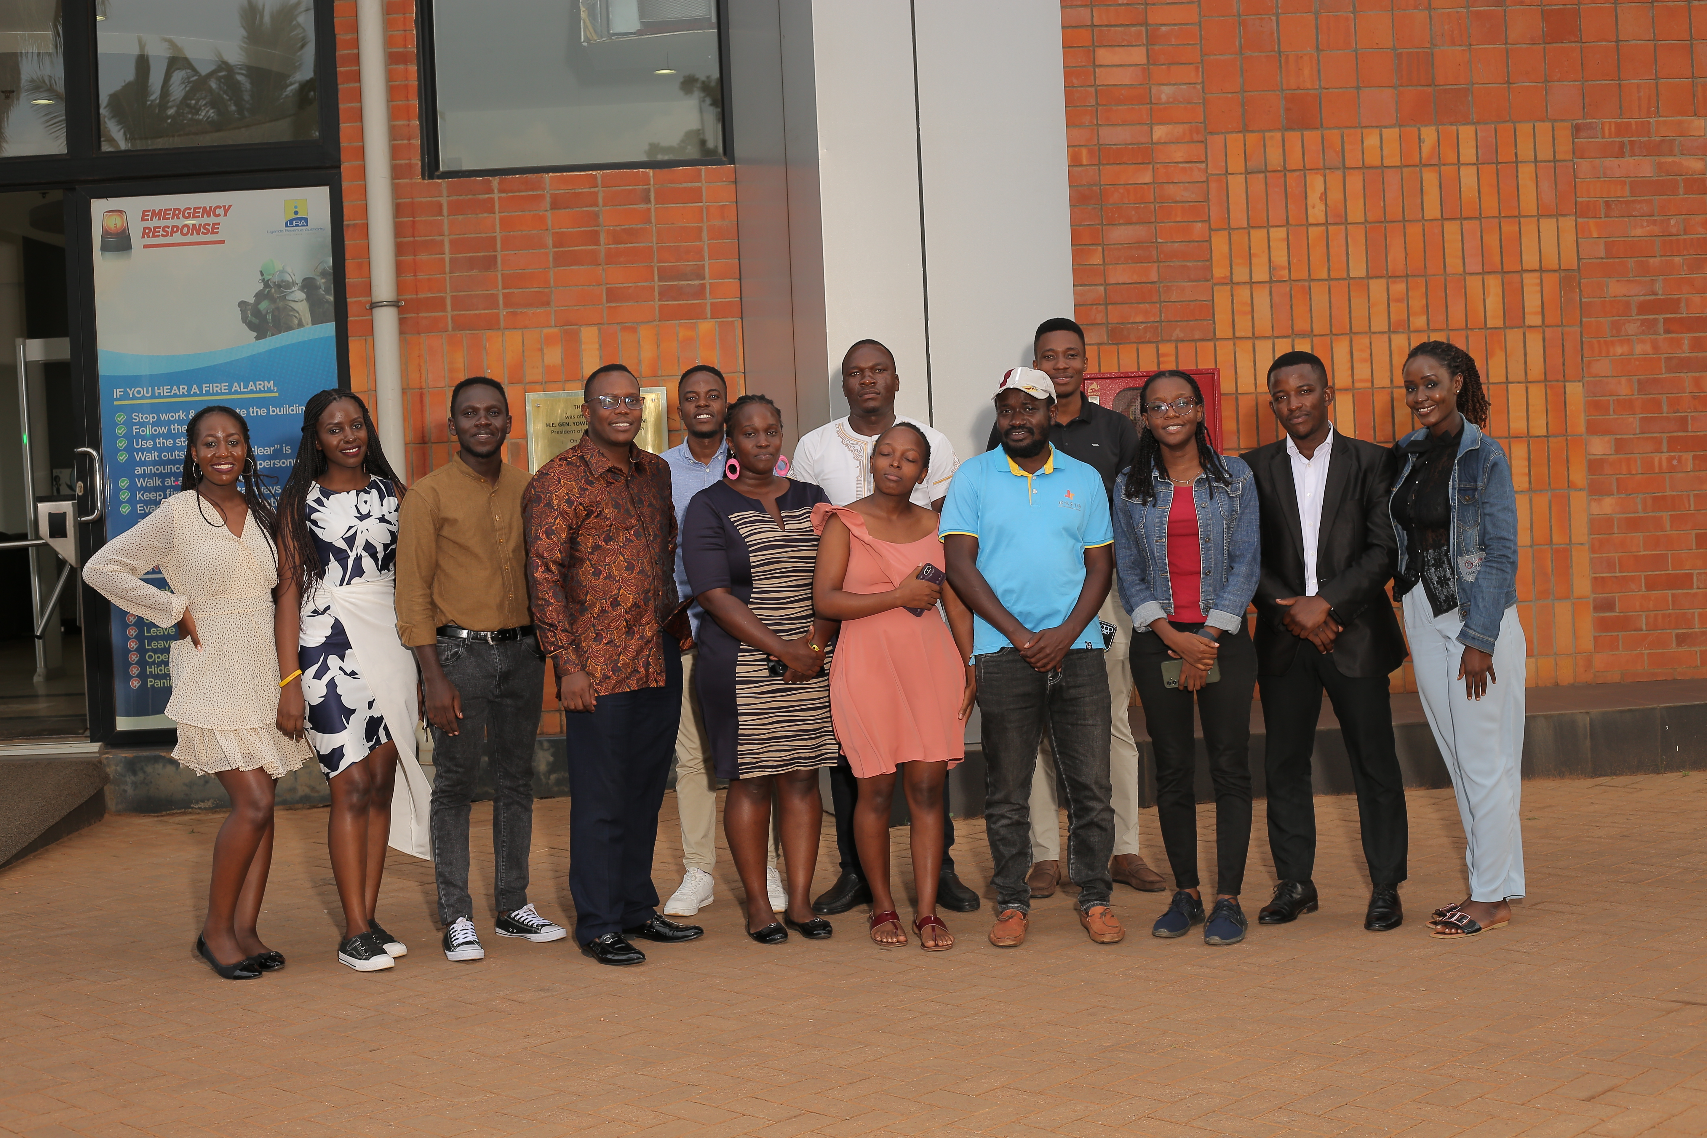
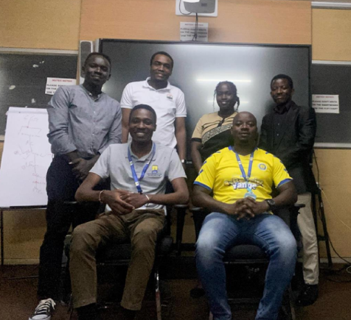
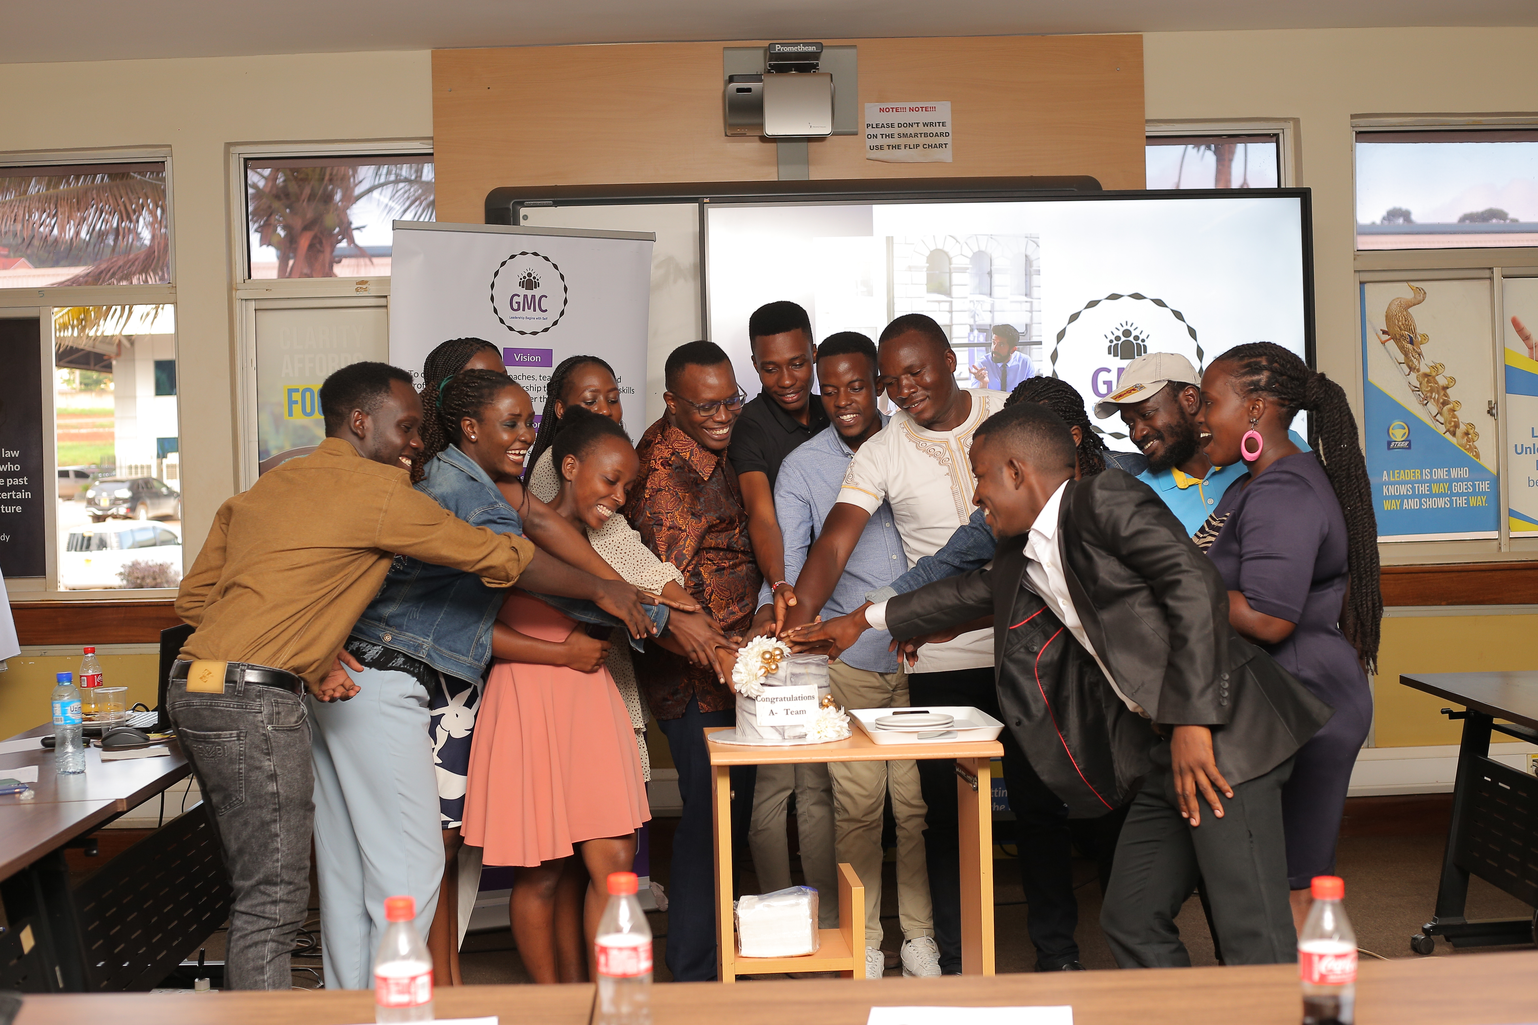
Background
Launched in 2024, the GMC initiative began with the first cohort of GMC founders (five committed partners) who underwent a two-month mentorship program focused on leadership and public management. These pioneers, inspired by AUNUA’s expertise played a vital role in mastering the program, analyzing and modifying it to fit its purpose and therefore replicating it by sharing their knowledge with a second cohort of 12 partners. Over two months, these partners participated in hybrid mentorship sessions, blending virtual and in-person training to prepare them to become catalysts for change. They graduated in May 2024, fully equipped to spread the program’s positive impact throughout their communities.

Slide 5
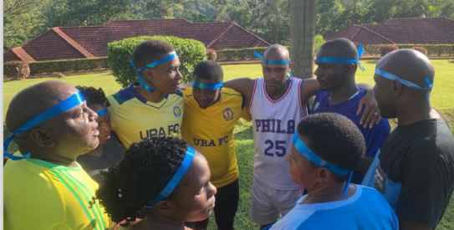

Values
The core values of the GMC program including character, influence, personal growth, problem-solving and creating meaningful change form the foundation of empowerment and community transformation which therefore result into a positive cycle of self-reliance and social equity.

Slide 6
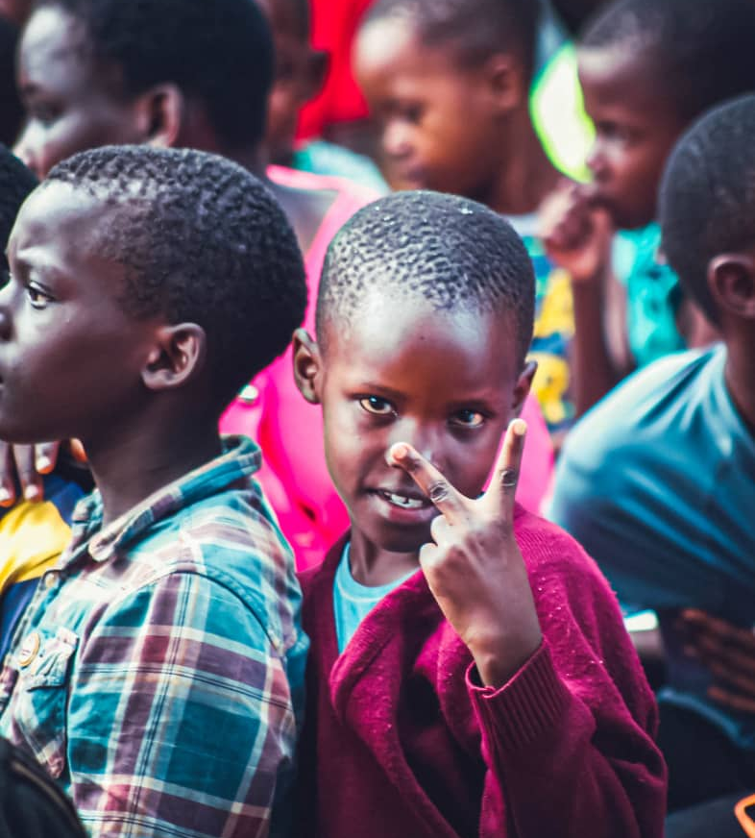
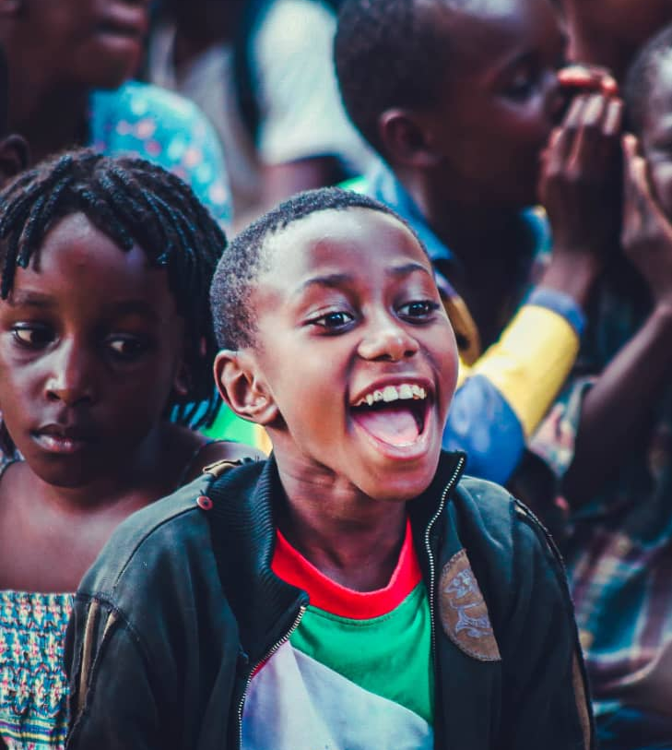
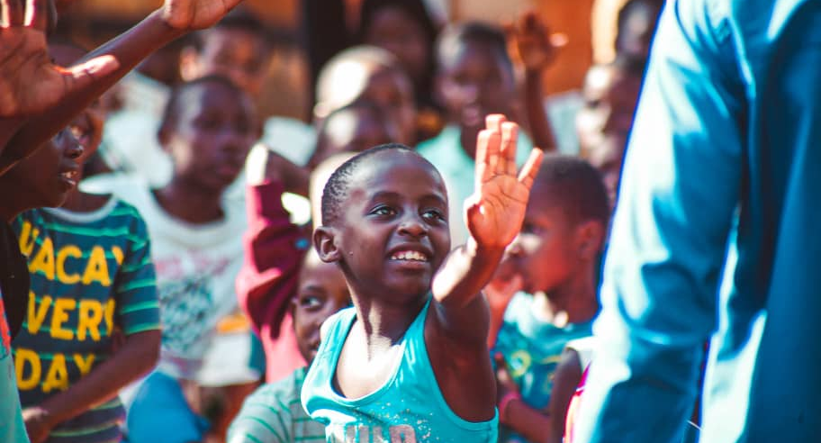
We believe that every individual, regardless of their background, has valuable ideas and potential that can create change, both for themselves and their communities. This belief drives our work and reflects our commitment to fostering empowerment, sustainability, and social equity.

Slide 7
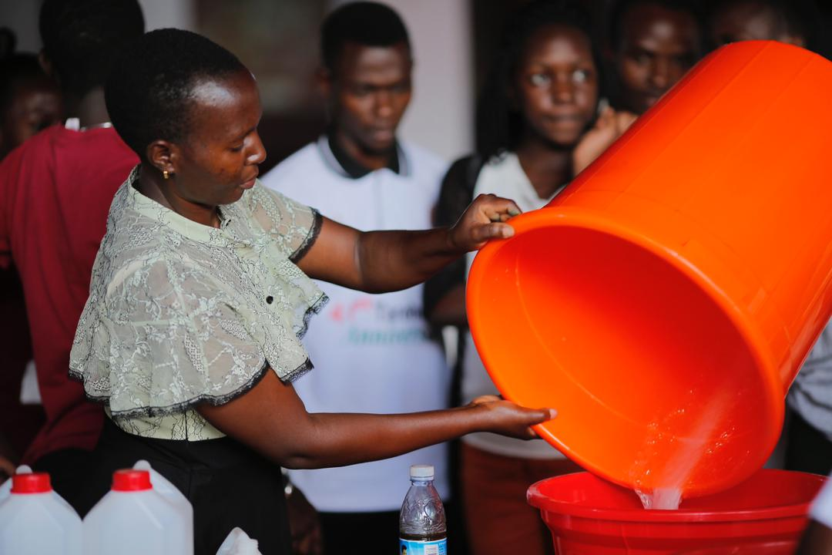
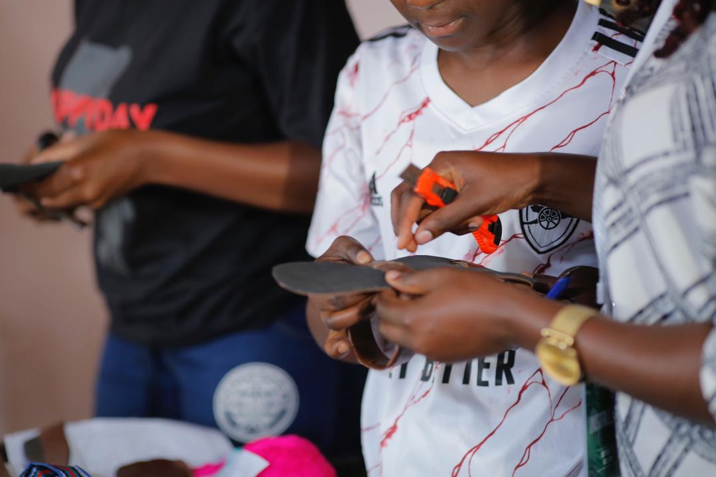
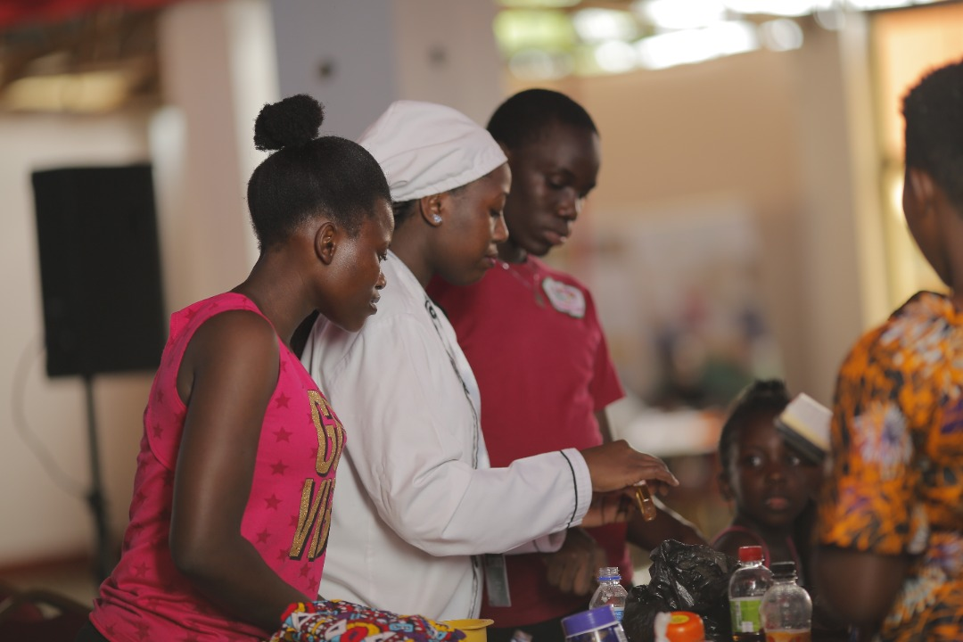
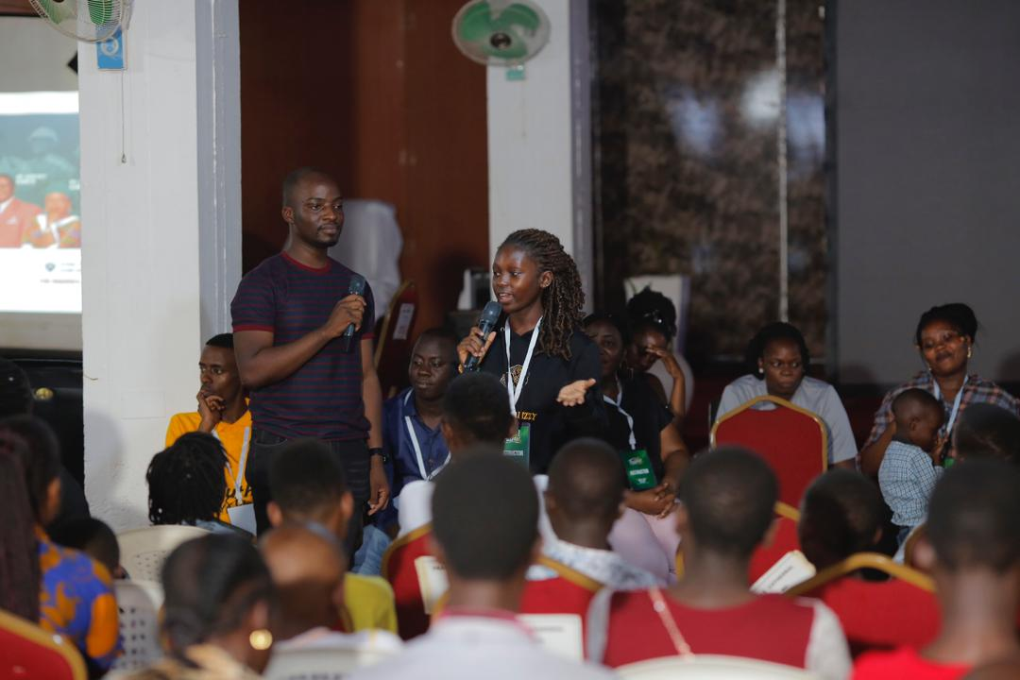
Impact expansion
To broaden the program’s impact, we have expanded our focus to include entrepreneurship and sexual reproductive health, both crucial aspects of improving the target groups' quality of life. Through the entrepreneurship component, participants gain essential financial literacy skills ranging from savings, capital management, income handling, to understanding market dynamics and digital entrepreneurship. This allows them to engage in economic activities that foster independence and unlock opportunities for financial freedom. Additionally, we encourage creativity such as arts and crafts, writing, music composition, singing, acting, production, fashion, makeup, and agriculture etc by employing the ROAR approach to help the target groups recognize their strengths, build resilience and lead their lives with confidence hence realizing additional avenues for sustainable income.

Slide 8
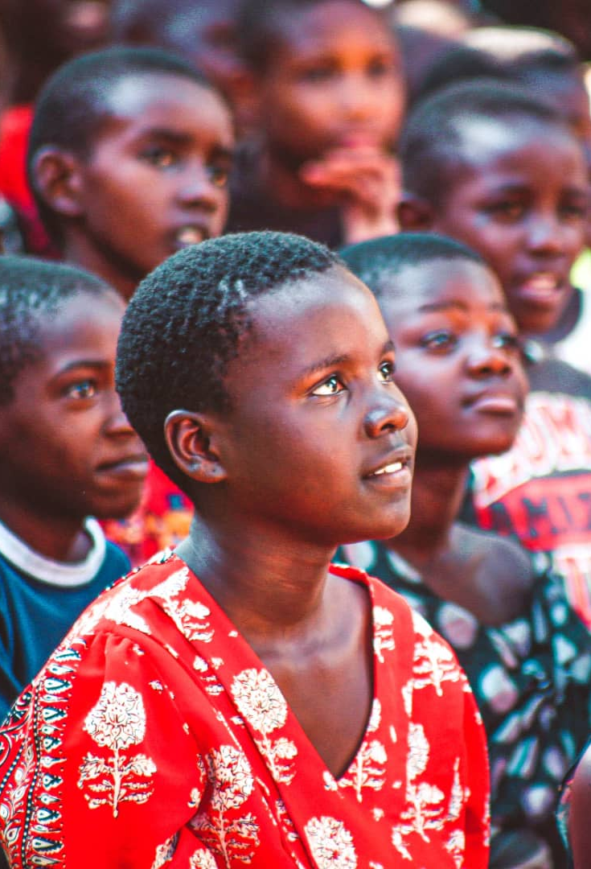
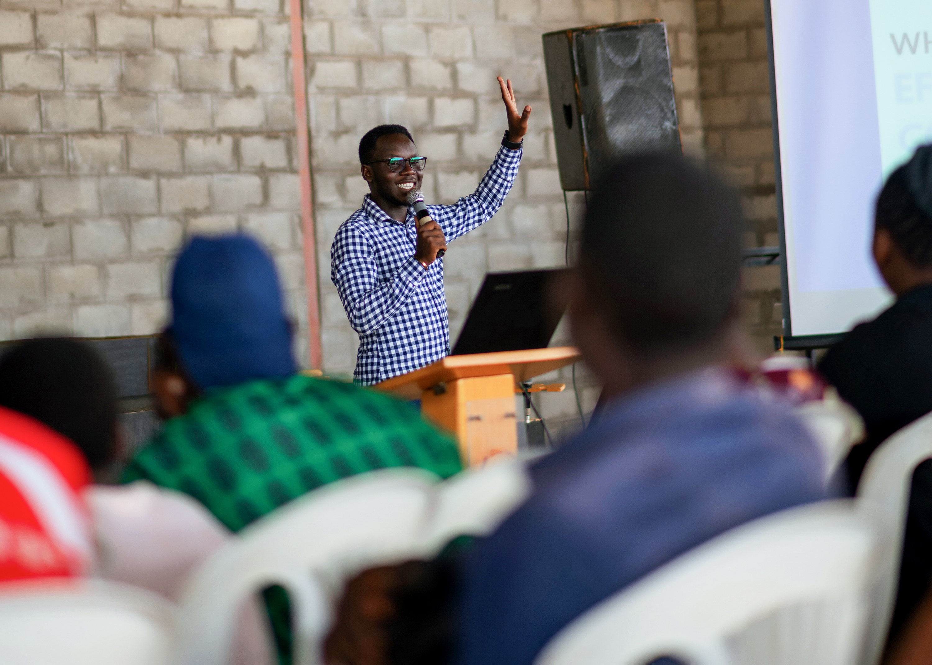
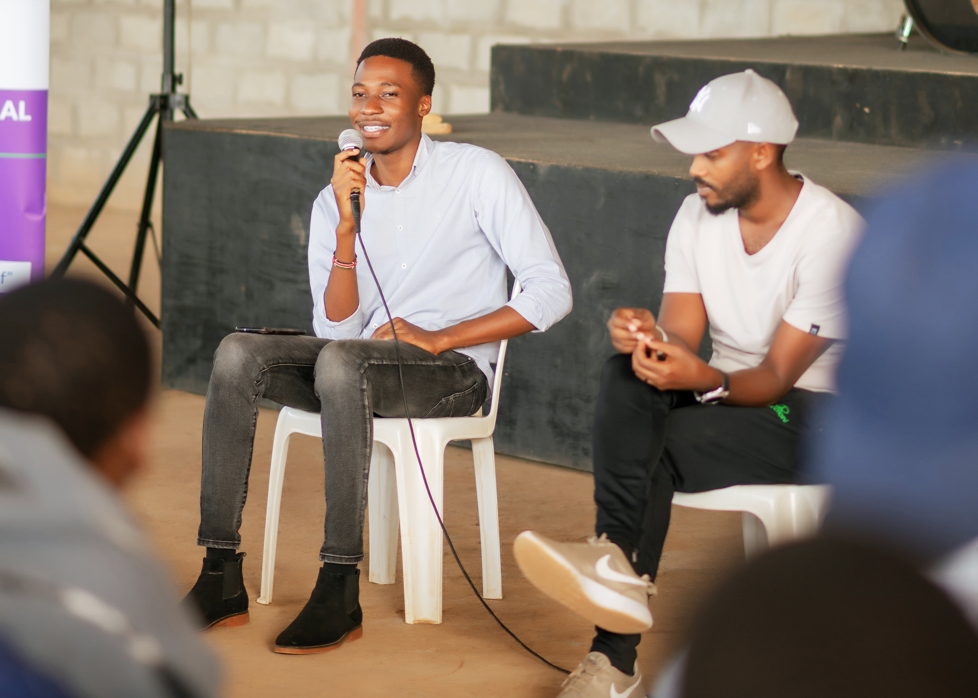
Sexual reproductive health education is aimed at empowering young people to make informed decisions as they transition to adulthood, helping them stay safe, protect themselves from sexually transmitted diseases and improve their overall health.

Slide 9
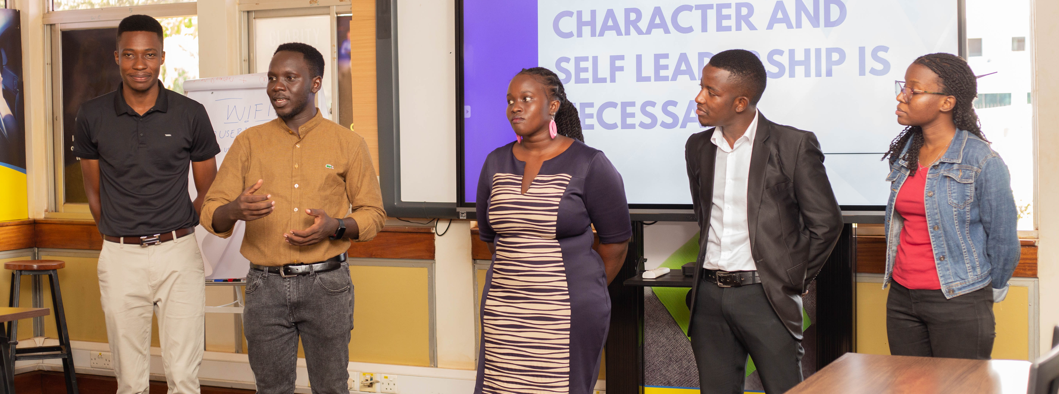
Our Journey
The program includes timely check-ins with the beneficiaries over six months to ensure participants are equipped with the skills they need to thrive and track their impact in their communities as heroes.

Slide 10
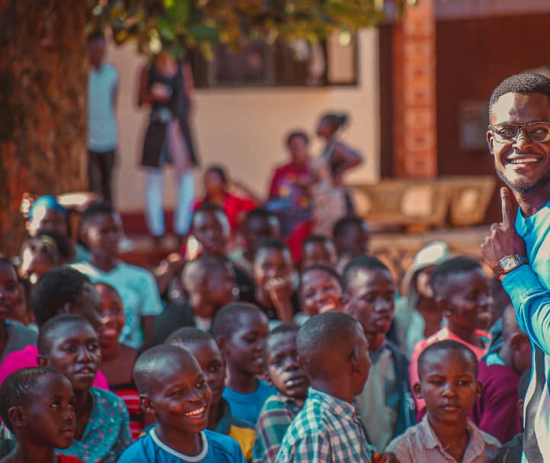
In September 2024, GMC collaborated with a community-based organization in one of Kampala’s slum areas to support 50 children aged 7-18years. These young people are already living the program’s values by sharing what they have learned with their peers which elaborates the continuity of the cycle of empowerment.

Slide 11
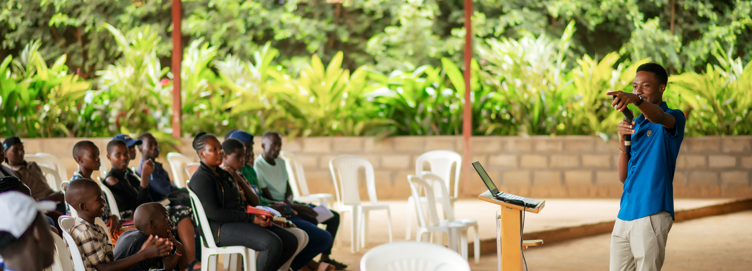
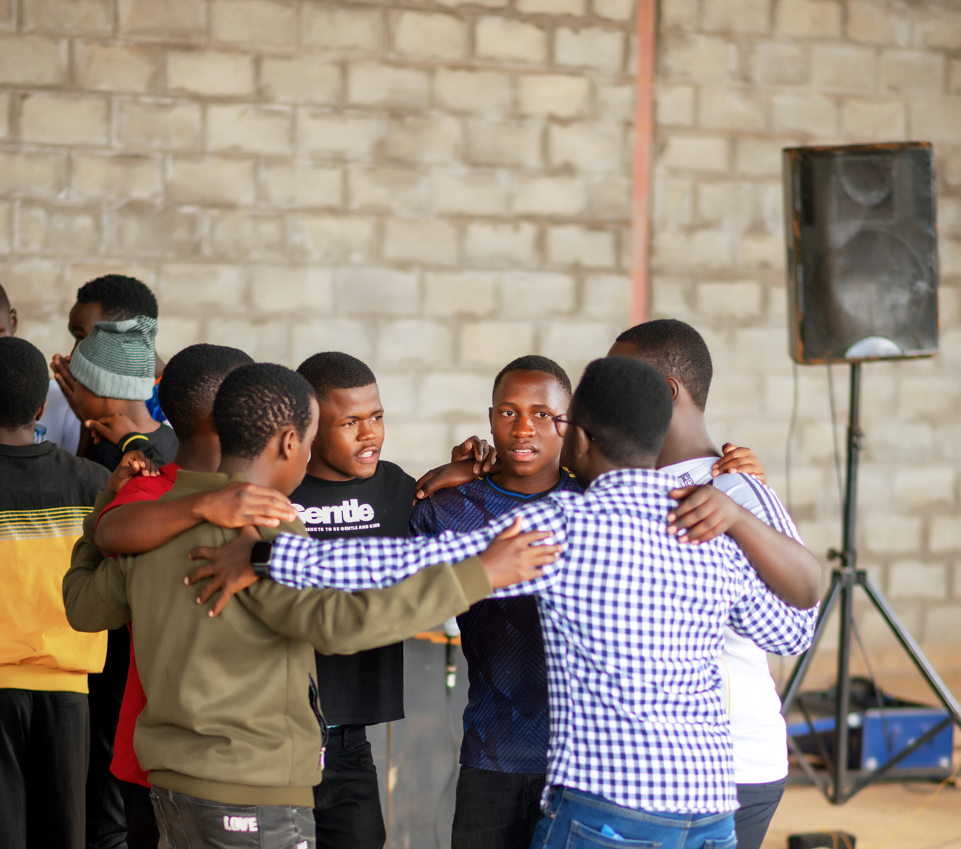
The Future
Looking ahead to 2025, we plan to extend the program’s reach by rolling out school outreach programs and establishing clubs where students can discover their unique abilities and learn how to make a positive impact in their communities. We will also introduce programs for teachers, preparing them to become mentors who inspire future leaders. Early discussions with three schools in Western Uganda are underway, with approvals expected in February and March 2025. Additionally, we are prioritizing People with Disabilities (PWDs) as a key group to benefit from the program, ensuring that no one is left behind in our collective journey toward empowerment and lasting change. Research and consultations with field practitioners are underway to guide our provisions as we are currently developing approaches to share with beneficiaries in this category i.e persons with visual, audio/hearing, speech Impairments etc,
By expanding the program to more individuals in diverse settings, The GMC plays the foundation for a more empowered, sustainable and equitable future. Together, we are not only addressing immediate challenges but building a community of leaders who will continue to drive positive changes for generations to come. This is a solid, sustainable solution for the future one that transforms lives, strengthens communities and creates lasting social impact.

Slide 12
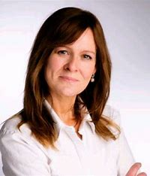

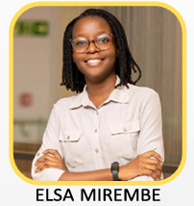
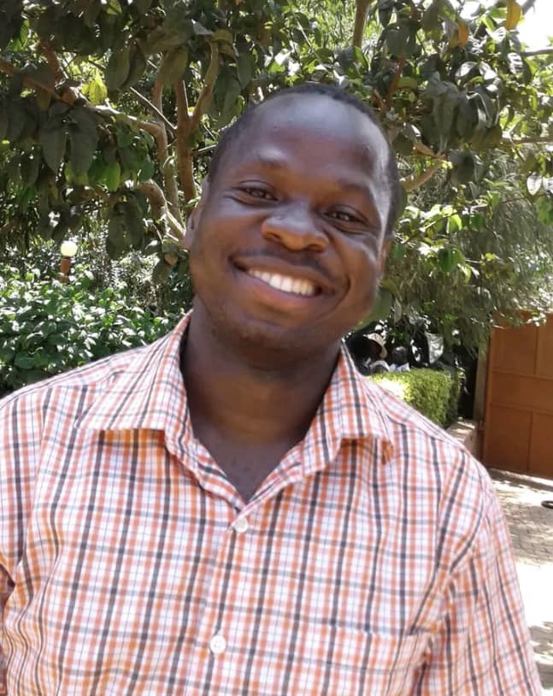

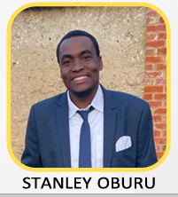
Our Team
Sharon Kyoshaba
Karina Murray
Elsa Mirembe
Nathan Waiswa
Julius Ceaser Ssuubi
Stanley Oburu

Slide 13
REACH OUT
Tel: +256 392 552 547 / +256 762 138 012
Email : thegmc.ug@gmail.com
Address : Kampala, Uganda

